Slide 1

Elush
SAP/PIVOTAL/WINCOR Integration

Slide 2
SAP/Pivotal/Wincor Integration Landscape
SSIS Jobs
Transaction Notification
SAP
Integration DB
PIVOTAL
SSIS Jobs
SAP Integration
Upload Wincor Interface File
WINCOR

Slide 3
Transaction Notification Scripts to push SAP data to Integration DB
Stored Procures in SAP database to push SAP data to Integration DB:
SBO_SP_PostTransactionNotice
sp_AI_TransactionNotification_Integration

Slide 4
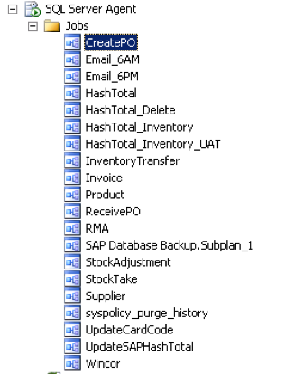
SQL Jobs
SQL Jobs | Description | Owner
CreatePO | SSIS Job to push PO data from Integration DB to Pivotal | APTEAN
Email_6AM | Set the mailing list for “inventory discrepancy email” | ABEO (Pivotal)
Email_6PM | Set the mailing to blank for “inventory discrepancy email” | ABEO (Pivotal)
HashTotal | SSIS Package to calculate the total sales amount for each outlets and populate into HashTotal table | APTEAN
HashTotal_Delete | Reset HashTotal and HashTotalInventory | ABEO (Pivotal)

Slide 5
SQL Jobs
SQL Jobs | Description | Owner
HashTotal_Inventory | Stored Procedure to captures inventory in SAP and Pivotal. This stored procedure will also takes into account all transactions that are still not yet processed in Integration DB | ABEO (SAP & PIVOTAL)
InventoryTransfer | SSIS Job to push Inventory Transfer data from Integration DB to Pivotal or vice versa | APTEAN
Invoice | SSIS Job to push Invoice data from Pivotal to Integration DB | APTEAN
Product | SSIS Job to push Product data from Integration DB to Pivotal | APTEAN

Slide 6
SQL Jobs
SQL Jobs | Description | Owner
RMA | SSIS Job to push Goods Return/RMA from Integration DB to Pivotal | APTEAN
StockAdjustment | SSIS Job to push stock adjustment data from Integration DB to Pivotal or vice versa | APTEAN
StockTake | Not applicable as Elush is using Stock Adjustment for Stock Take | APTEAN
Supplier | SSIS Job to push Supplier information from Integration DB to Pivotal | APTEAN
UpdateCardCode | ???

Slide 7
SQL Jobs
SQL Jobs | Description | Owner
ReceivePO | SSIS Job to push PO Receiving data from Pivotal to Integration DB | APTEAN
Wincor | SSIS Job to push Wincor data from Integration DB to Pivotal. Before this step, Wincor data will be uploaded to Integration DB. | APTEAN

Slide 8
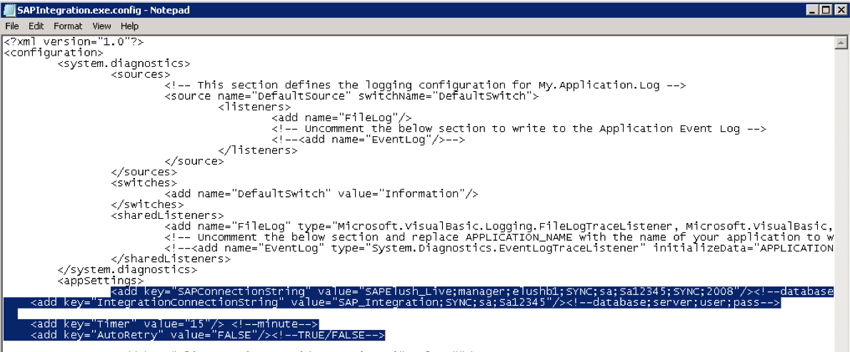
SAP Integration Configuration
Path: E:\IntegrationService\SAPIntegration.exe.config
Set SAP Database Name, Integration DB database name, SAP user credential, SQL Server, SQL user credentials.
Timer value: Set the frequency to push from Integration DB to SAP if the AutoEntry value is True.

Slide 9
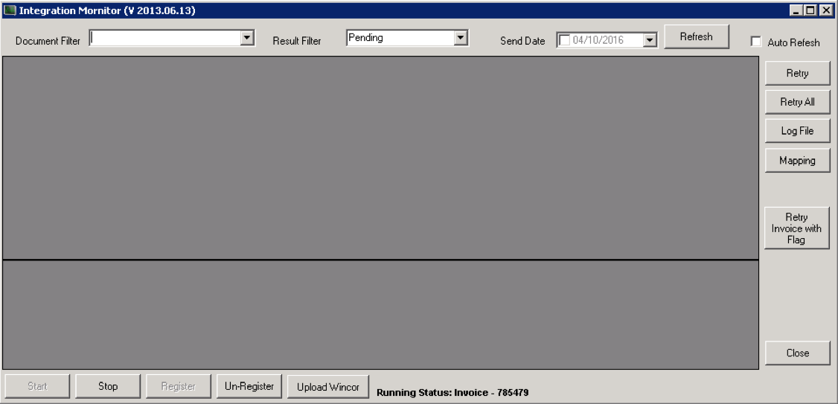
Integration Monitor
Path: E:\IntegrationService\SAPIntegration.exe
Register and Start to activate the integration from Integration DB to SAP
Stop and Un-Register to deactivate the integration from Integration DB to SAP
Please ensure this program only registered once in Database server (not in any other PC/servers)
Retry: Highlight the pending transaction and Retry one record
Retry All: Retry all pending transactions.

Slide 10
Integration Monitor
Log File: To view the Log File
Document Filter: Select the object to view
Result Filter: Pending, Failed, Successful, All
Send Date: Filter by Send Date
Retry Invoice with Flag: ???

Slide 11
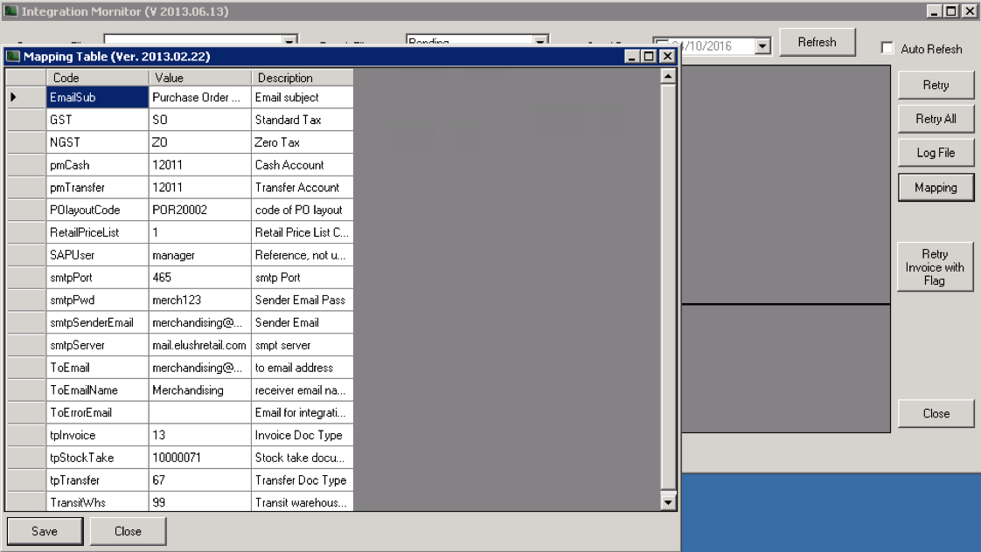
Integration Monitor - Mapping
smtPort, smtpPwd, smtpSenderEmail, smtpServer: Email Credentials
Others: SAP related settings

Slide 12
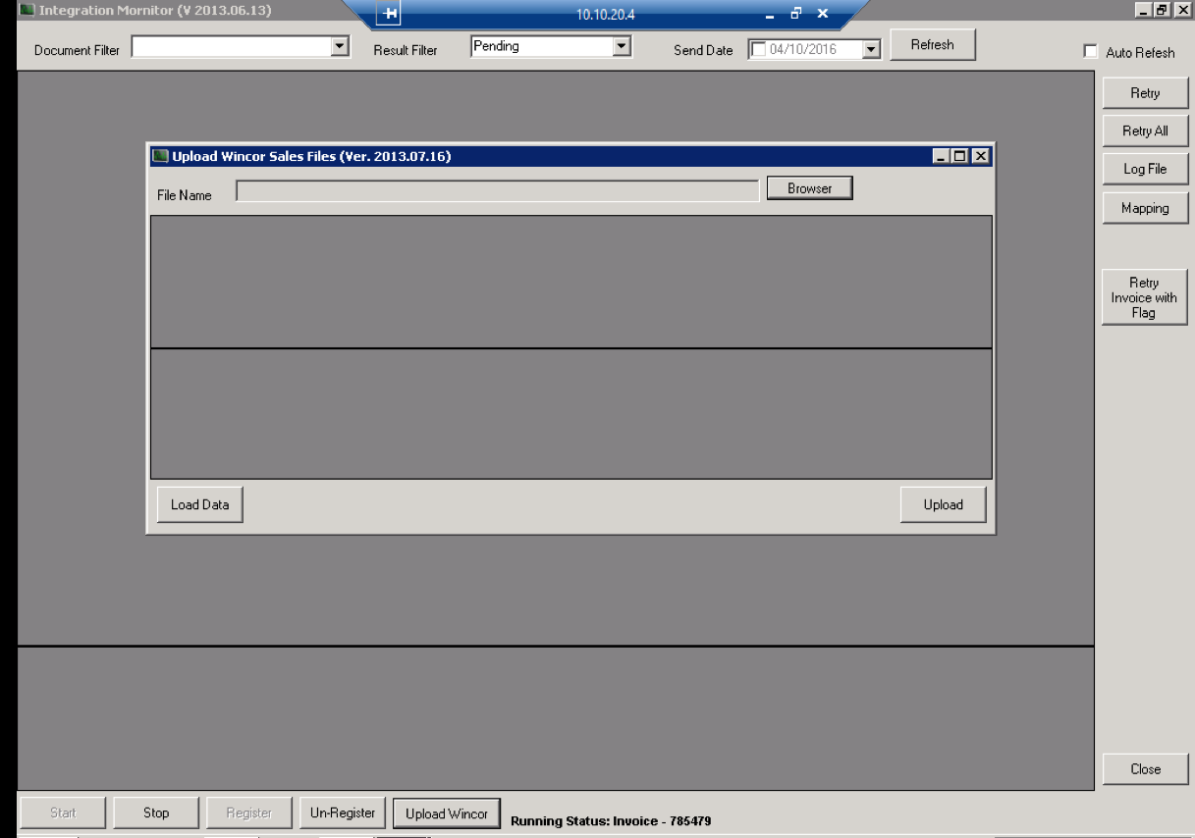
Upload Wincor (for Airport Stores only)
Upload Wincor button to launch screen to upload Wincor interface file to Integration DB (WC_InvoiceHeader, WC_InvoiceLine, WC_PaymentMean)
Elush will download Wincor interface files from FTP sites provided by Wincor

Slide 13
Integration Flows
Table | Description | Direction
Item | Item Master | From SAP
BP | Business Partner | From SAP
POHeader | Purchase Order Header | From SAP
POLine | Purchase Order Detail | From SAP
POReceiptHeader | Goods Receipt PO Header | From Pivotal
POReceiptLine | Goods Receipt PO Detail | From Pivotal
GoodsReturnHeader | Goods Return Header | From Pivotal
GoodsReturnLine | Goods Return Detail | From Pivotal
InvoiceHeader | AR Invoice Header | From Pivotal
InvoiceLine | AR Invoice Detail | From Pivotal
Payment Means | Incoming Payment Means | From Pivotal

Slide 14
Integration Flows
Table | Description | Direction
TransferHeader | Inventory Transfer Header | Both
TransferLine | Inventory Transfer Detail | Both
IssueHeader | Inventory Goods Issue Header | From SAP
IssueLine | Inventory Goods Issue Detail | From SAP
ReceiptHeader | Inventory Goods Receipt Header | From SAP
ReceiptLine | Inventory Goods Receipt Line | From SAP
SerialNumber | For all transactions | Both

Slide 15
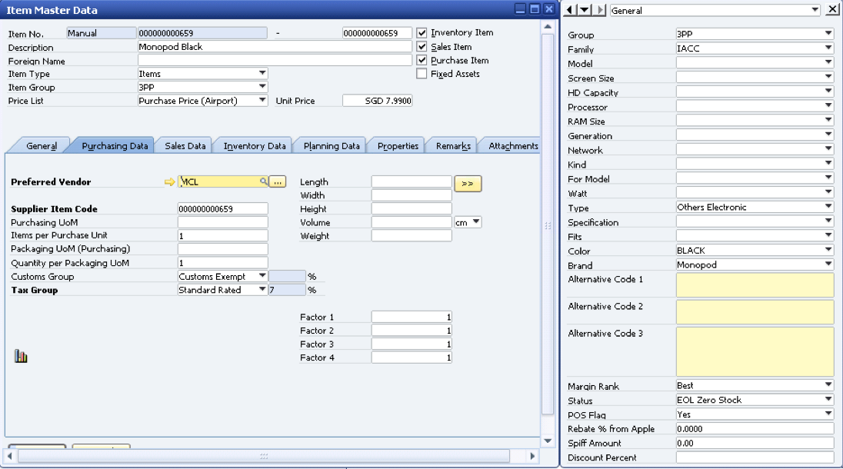
Integration Flows – Item Master
Direction from SAP if POS Flag = Yes
Preferred Vendor = Ensure the vendor is created in SAP/Pivotal

Slide 16
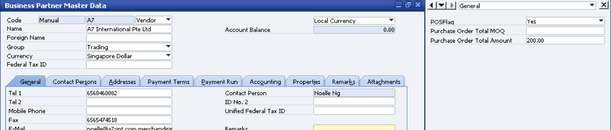
Integration Flows – Business Partner
Direction from SAP if POS Flag = Yes and Type = Vendor

Slide 17
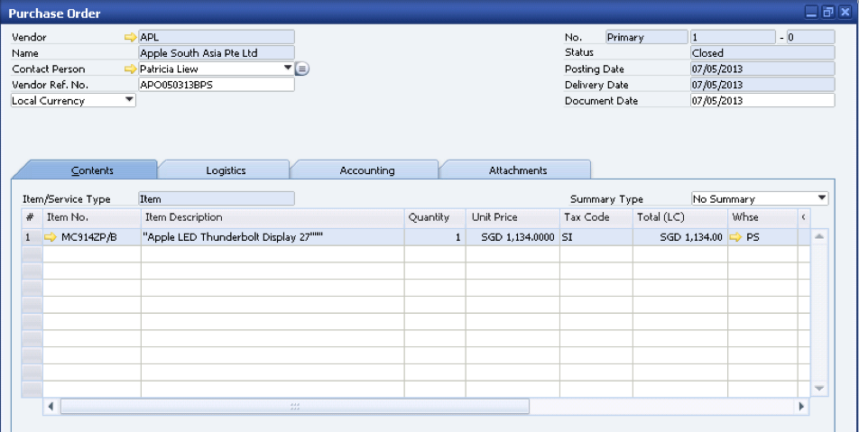
Integration Flows – Purchase Order
Data will be sent from SAP to Integration DB if Whse = Outlets warehouse
To check Outlets warehouse go to menu path (Administration > Setup > Inventory > Warehouse > POS Flag = Yes

Slide 18
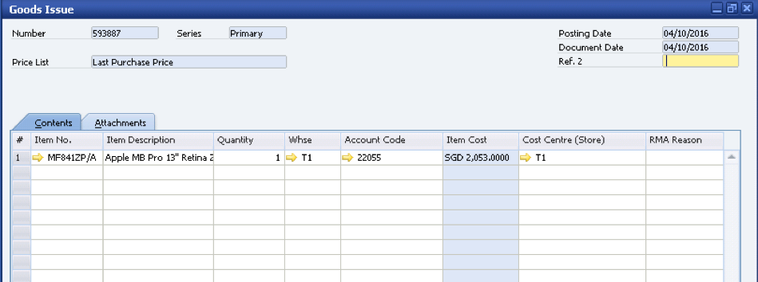
Integration Flows – Goods Issue and Goods Receipt
Goods Issue and Goods Receipt is used to adjust the stock in SAP (and Pivotal)
Data will be sent from SAP to Integration DB if Whse = Outlets warehouse
To check Outlets warehouse go to menu path (Administration > Setup > Inventory > Warehouse > POS Flag = Yes

Slide 19
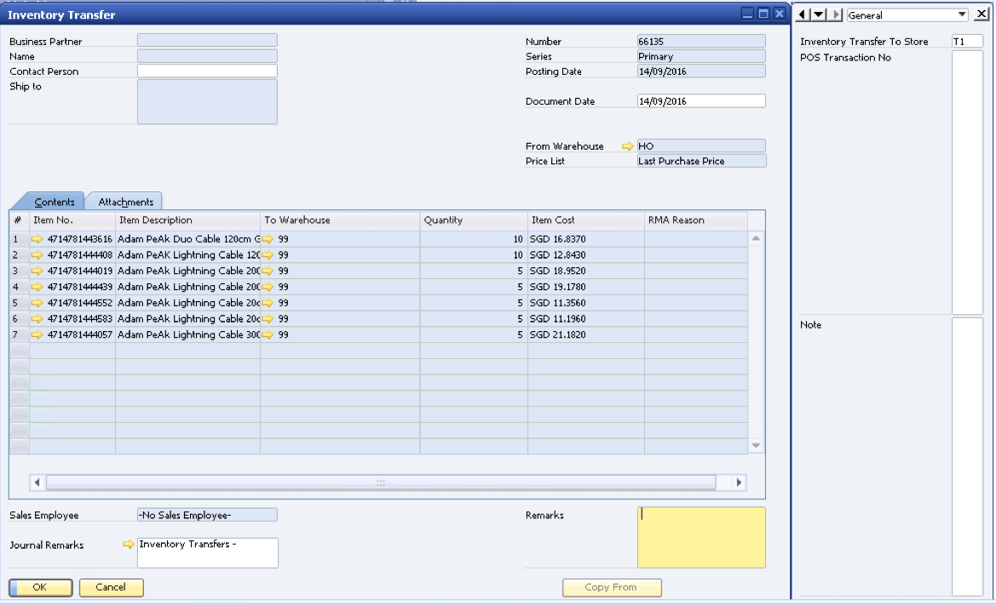
Integration Flows – Transfer
Data will be sent from SAP to Integration DB if From Warehouse = HO, To Warehouse (row level) = 99, Inventory Transfer To Store = Outlets warehouse
To check Outlets warehouse go to menu path (Administration > Setup > Inventory > Warehouse > POS Flag = Yes

Slide 20
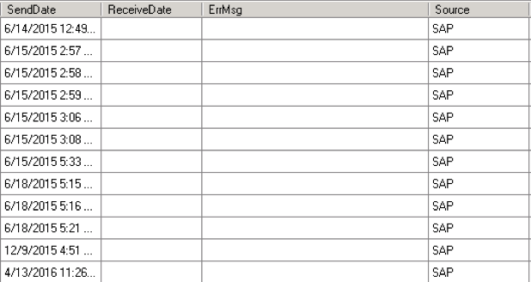
Integration DB – Common Fields
SendDate: Date/Time stamp when the source system (SAP/Pivotal) send data to Integration DB
ReceiveDate: Date/Time stamp when the destination system receive the data from Integration DB
ErrMsg: Error Message in destination system for the cause of failed transaction
Source: Source system (SAP or Pivotal)
U_POSTxNo: Pivotal Transaction Number. This is common for all transactions. You can reconcile SAP transaction with Pivotal transaction using this number.

Slide 21
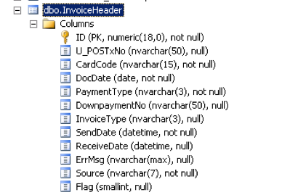
Integration DB – InvoiceHeader table
Payment Type: IN (normal invoice with incoming payment), OUT (returns/void with outgoing payment), BLK (exchange or no payment required)
InvoiceType: INV (invoice), RES (deposit)
DownpaymentNo: Deposit No

Slide 22
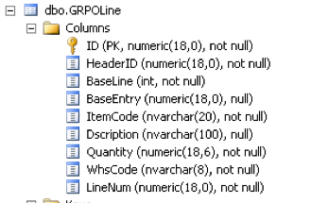
Integration DB – GRPOLine
HeaderID: Link to GRPOHeader table
BaseLine: SAP PO Line #
BaseEntry: SAP PO Document Entry

Slide 23
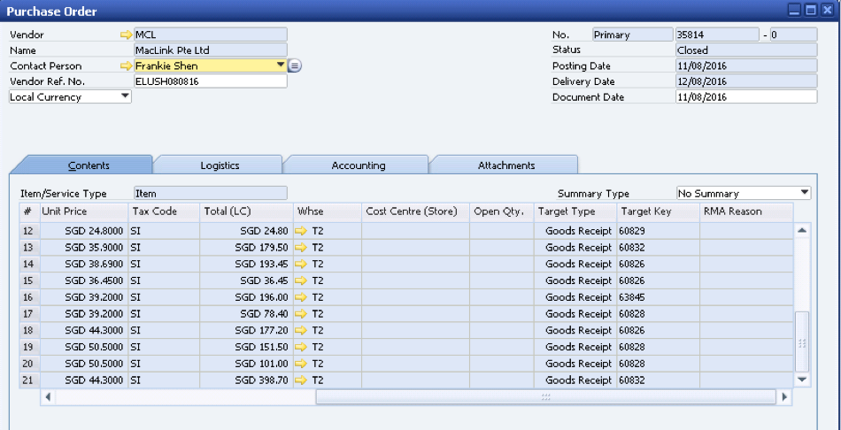
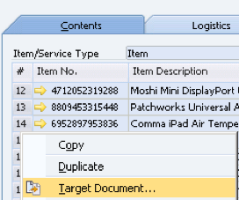
To check PO target document
Open Purchase Order – Fields: Target Type: GRPO, Target Key: GRPO #
Alternatively, you can highlight the transaction row and go to Target Document

Slide 24
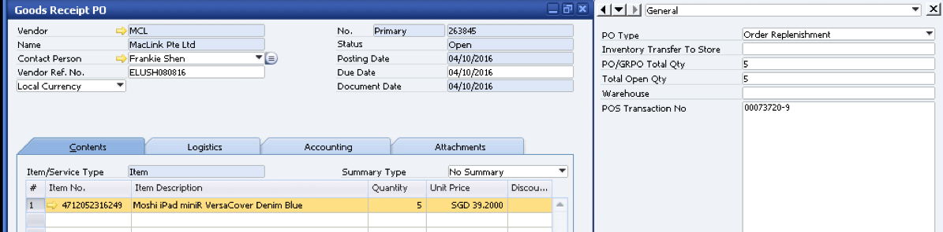
To check GRPO base on Pivotal PO Receiving Number (POSTxNo)
On GRPO, ensure the extension screen for UDF is displayed (View > User Defined Fields)
Search by POS Transaction No (reference to Pivotal)
Search by SAP No (reference to SAP)

